Slide 1
Introduction to Programming Language II(Java)
Fariha Zahin
Lecturer
CSE, Southeast University

Slide 2

Object Oriented Programming in JAVA

Slide 3
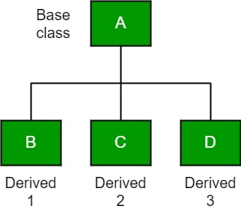
What is Inheritance?
Inheritance is a mechanism in Java where one class acquires the properties and behaviors (fields and methods) of another class.
The class that inherits is called Subclass (Child class).
The class being inherited from is called Superclass (Parent class).
Why Use Inheritance?
Code Reusability: Reuse existing code from the superclass.
Method Overriding: Modify superclass methods in subclass.
Runtime Polymorphism: Enables dynamic method dispatch.
Organizes Code: Establishes a natural hierarchy.

Slide 4
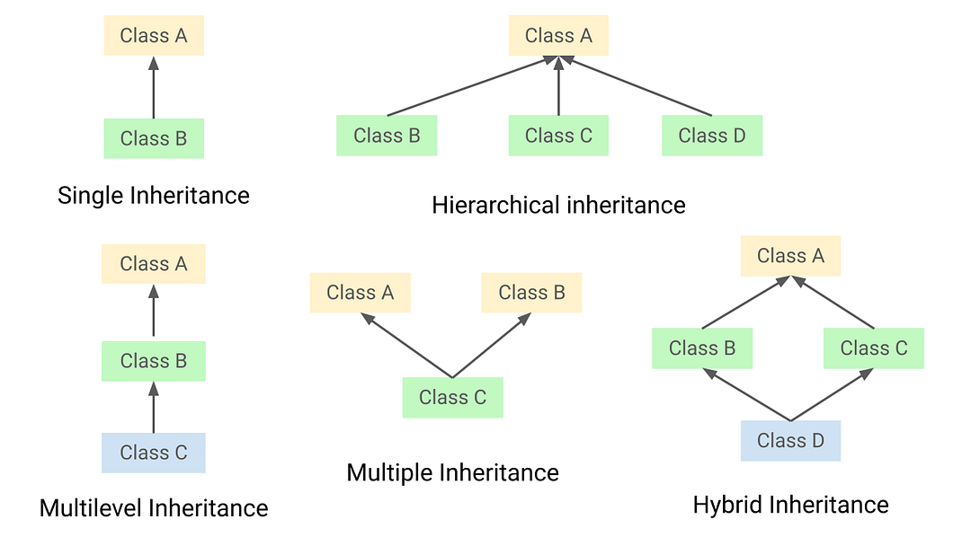
Types of Inheritance in Java
Single Inheritance
Multilevel Inheritance
Hierarchical Inheritance (Note: Java does not support multiple inheritance through classes. It is achieved using interfaces.)

Slide 5
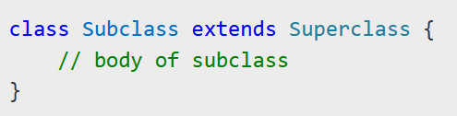
**Java uses the extends keyword to establish an inheritance relationship between a subclass and a superclass.
Syntax:
The subclass inherits accessible fields and methods from the superclass.
It allows the subclass to reuse, override, or add new functionality.

Slide 6
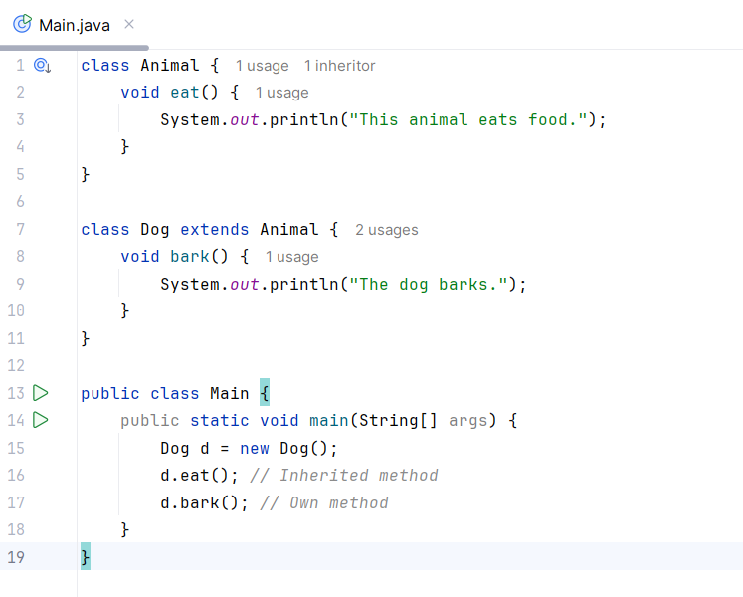
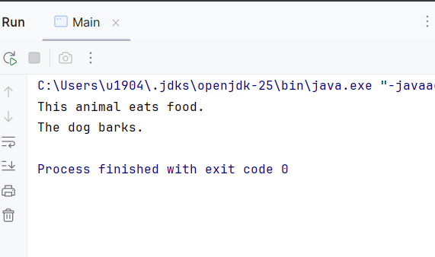
Single Inheritance
A subclass inherits from only one superclass.
Promotes code reuse and method overriding.

Slide 7
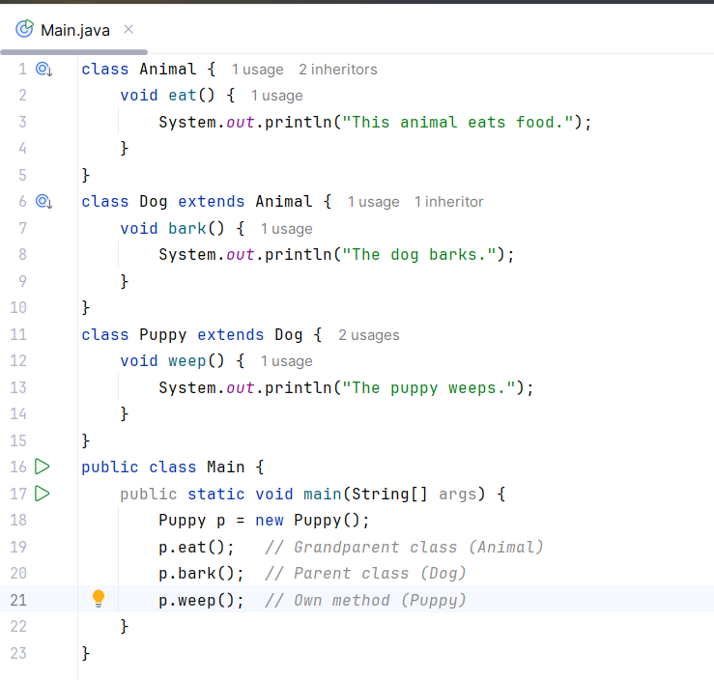
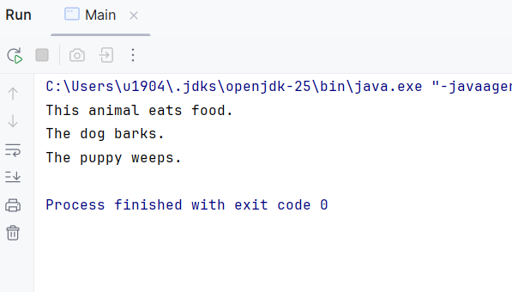
Multilevel Inheritance
A class is derived from another derived class, forming a chain of inheritance.
Supports multi-level code reuse.

Slide 8
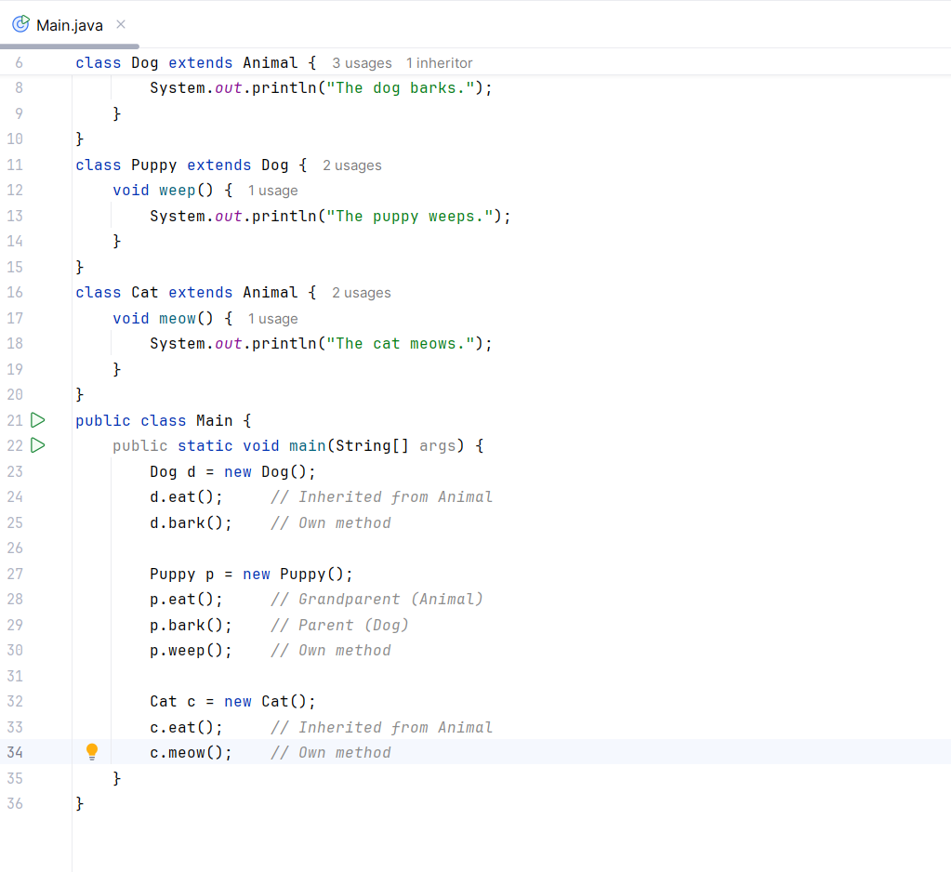
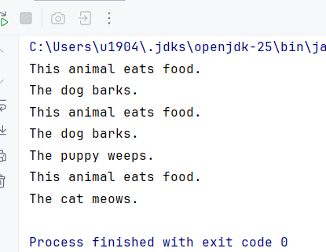
Hierarchical Inheritance
Multiple subclasses inherit from a
single superclass.
Promotes a hierarchical
classification.

